Slide 1



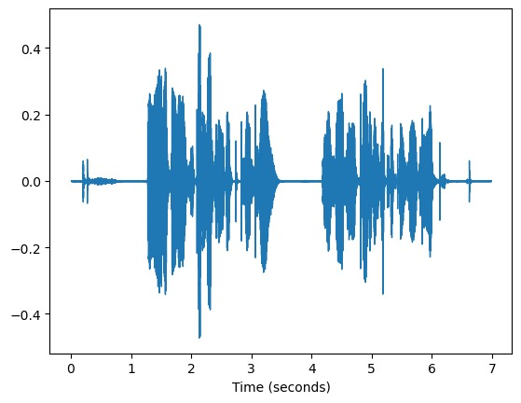
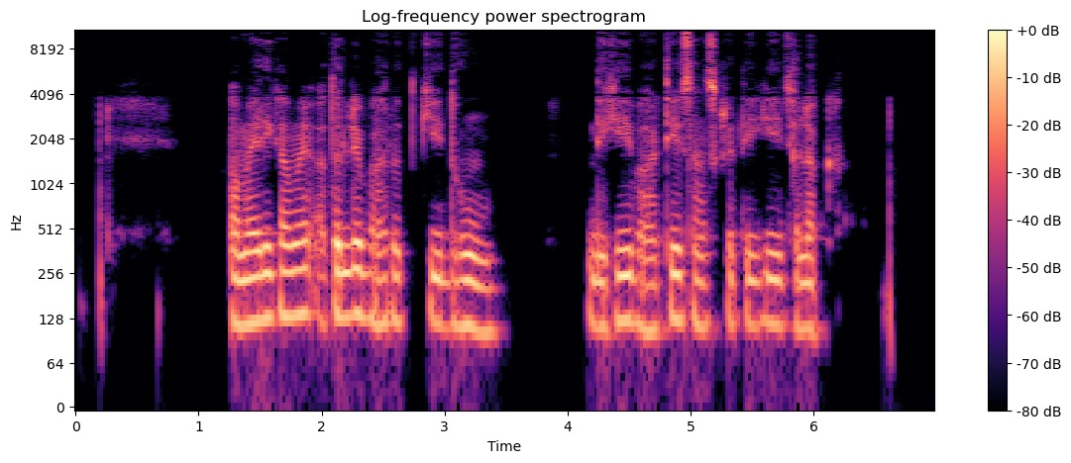
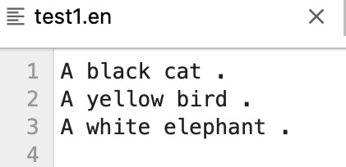
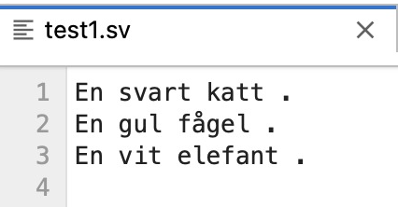
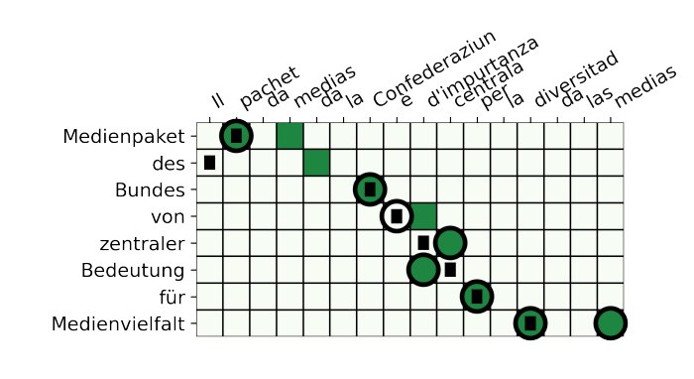
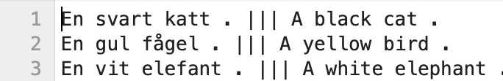


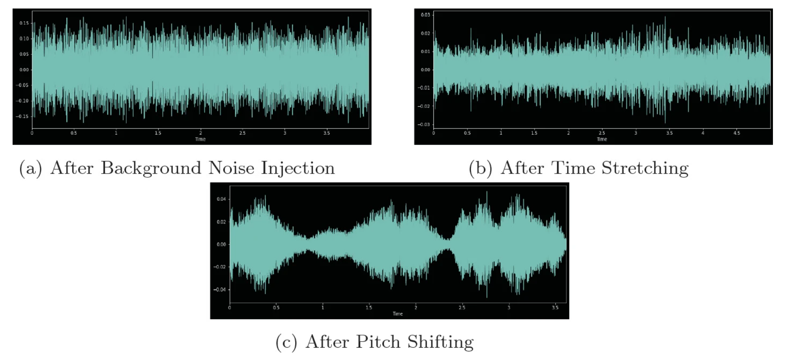
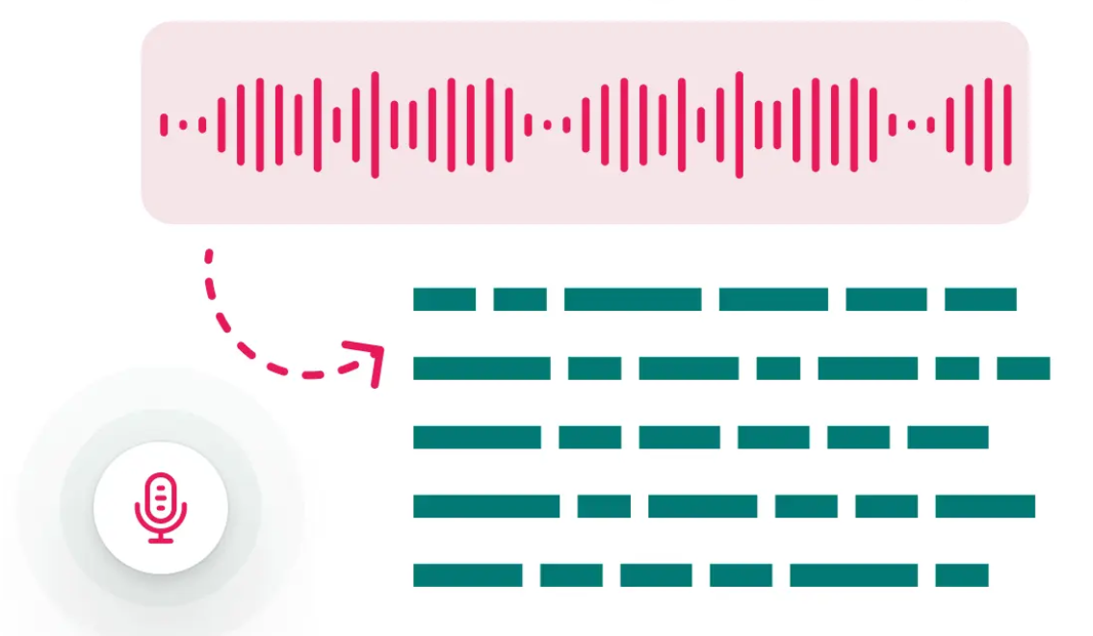
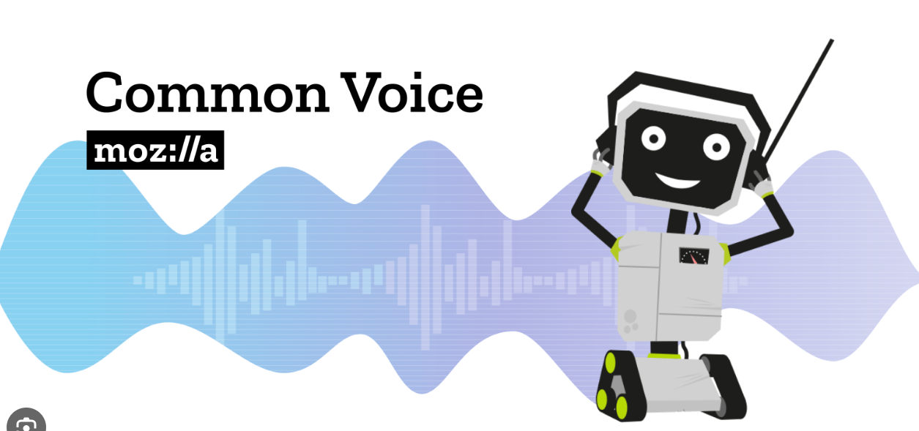
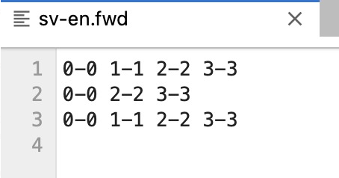
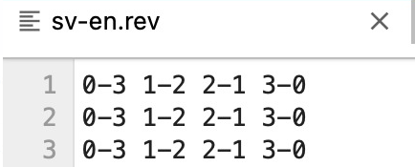
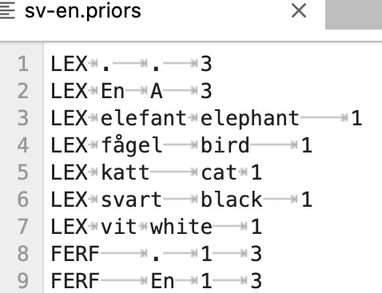
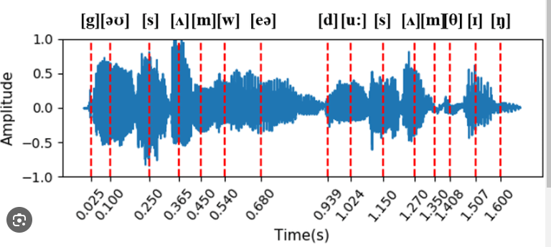

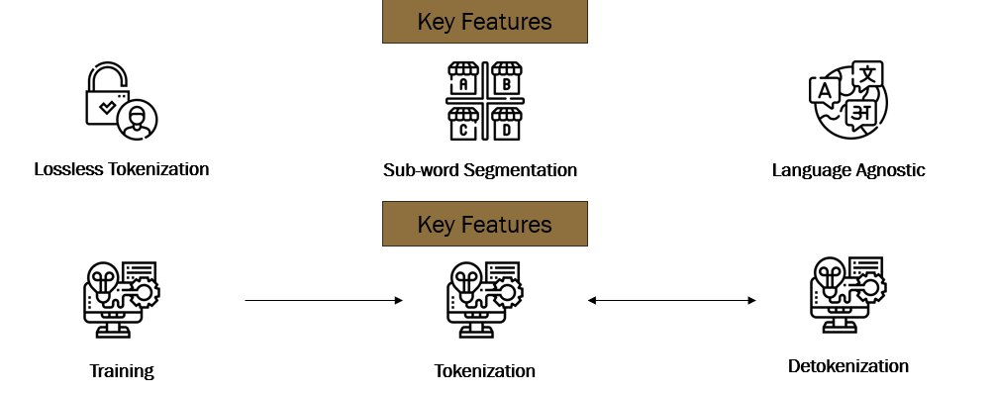
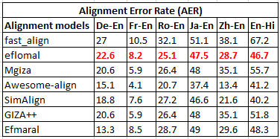
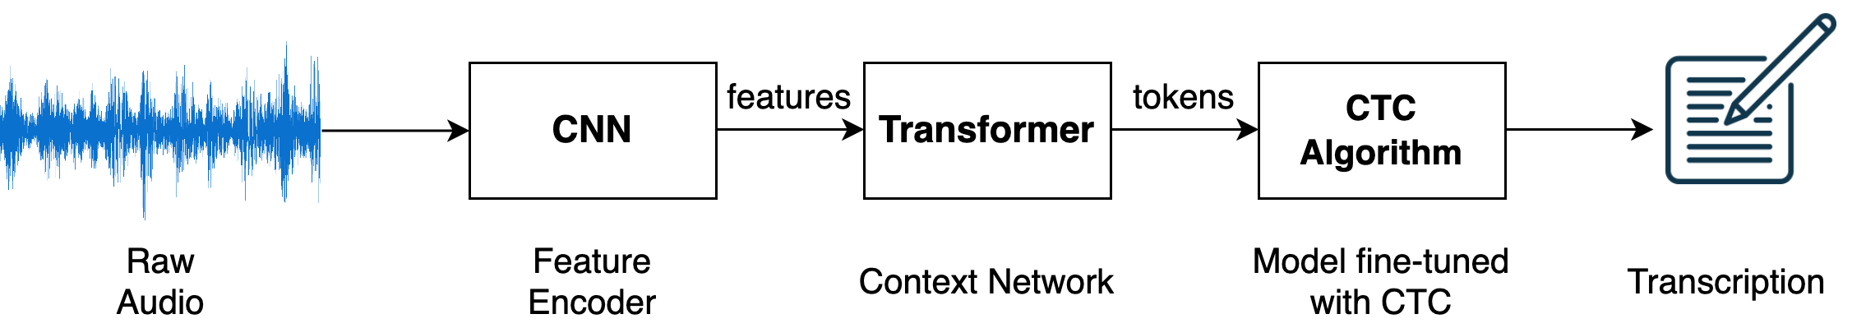
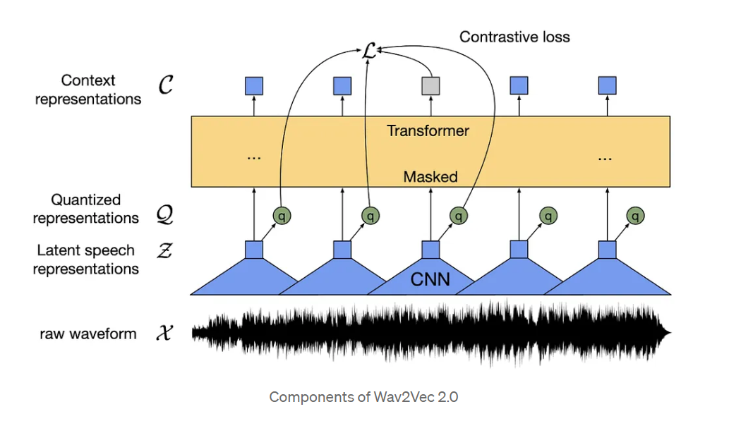
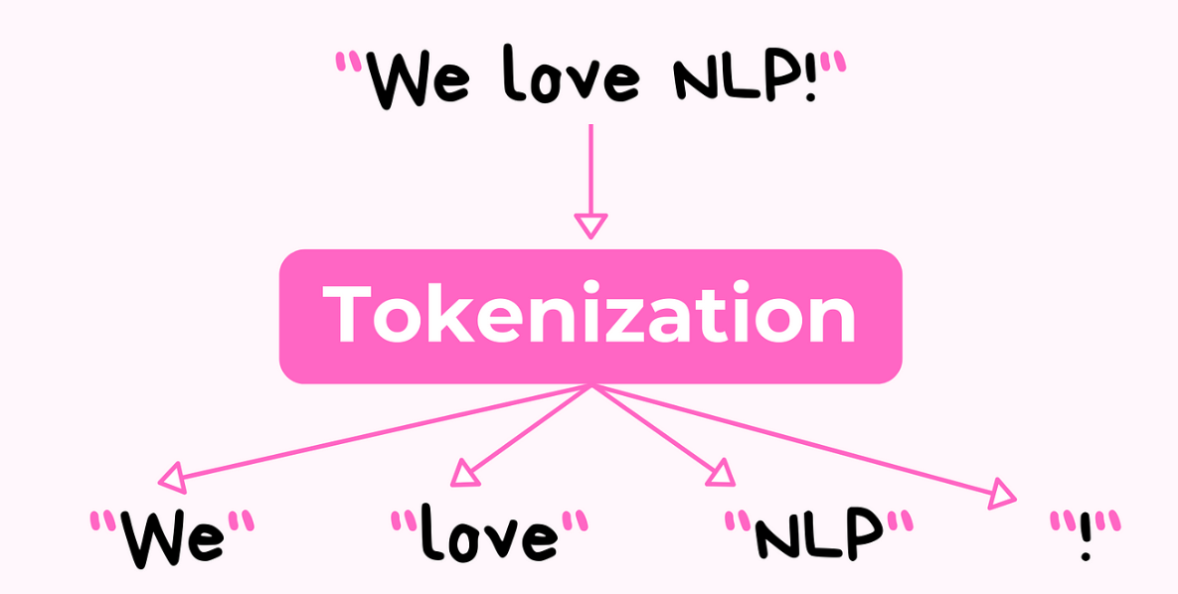
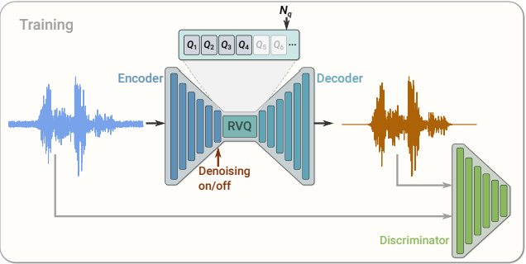
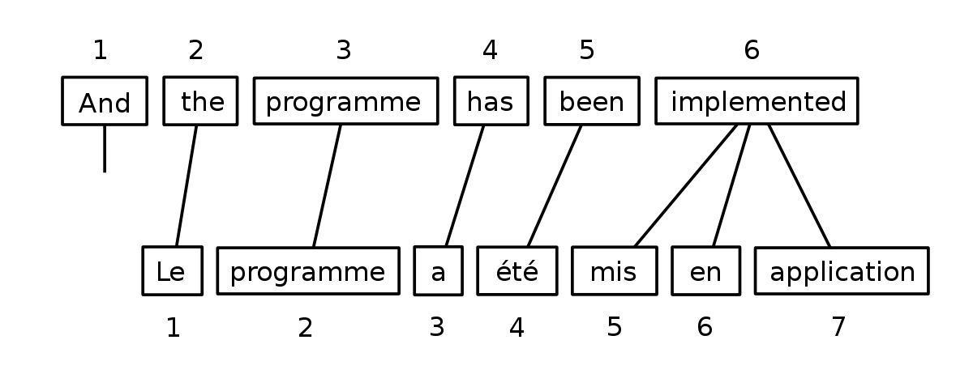





Audio-to-Text Alignment
Anupama M, Chinmay Gidwani, Kavyasri Jadala, Keertana Madan, Prathyusha Reddy Midudhula, Matthew A. Lanham
Purdue University, Daniel’s School of Business
m1@purdue.edu; cgidwani@purdue.edu; madaank@purdue.edu; kjadala@purdue.edu; pmidudhu@purdue.edu; lanhamm@purdue.edu
Business Problem Framing
Data
Model Building
The outputs from tokenization are aligned using Eflomal to achieve a synchronized result. Training on the Common Voice dataset further refines this alignment and fortifies the understanding of the model.
Imagine unlocking the vast universe of digital content for every corner of the world, no matter how remote or how rarely their language is spoken.
In our partnership with SIL International, a non-profit organization, we are working to create a future where educational and informative content can speak directly to everyone in their native language, making learning and accessing information a seamless, inclusive experience.
Data from the open source, Mozilla Common Voice (audio + text translations) of 120+ languages .
English transcript
Swedish transcript
ALIGNMENT MODELS
Mono - Lingual Context
Eflomal (Efficient Low memory aligner)
Iteration and refinement
Validate Model accuracy
Fig 5. Waveform & Spectrogram analysis
Assess and optimize model precision and efficacy
Bilingual Input Requirement:
Requires input files in both languages for analysis.
Eflomal processes these files to determine cross-language token mapping.
To answer this, our team is creating a language agnostic innovative system that automatically synchronizes audio and text across unseen languages to ensure they align without relying on speech recognition.
SIL’s aim is to vastly simplify the creation of multilingual educational materials without the need for language experts using this solution.
Waveform : Loudness over time; Spectrogram : Constituent frequencies, Variation of pitch over time. Data Preprocessing: Extract Spectrograms, enhanced by normalization, compression, & noise reduction
Re-train and optimize
Datasets (Labeled- Audio)
EXPERIMENTATION: INDUCING REAL WORLD INCONSISTENCIES
Cross - Lingual Context
RAW DATA:
1. Mozilla Common Voice (Monolingual) 2. Europarl-st (Multilingual)
Missing Audio Simulation
Missing Text Simulation
Transformer Models
Predictions
Model Deployment
Using eflomal we generate forward, reverse, and prior files which provides detailed mappings and alignment probabilities between languages.
Image generated from Dall-e
Introduce silences in random parts of audio files, matched with gaps in transcript to test performance w/real world data.
Forward Alignment
Reverse Alignment
Generating Priors
Phonemization
Now, the critical question we're exploring is: how much data is needed to teach this system effectively across languages that may share few similarities?
Analytical Problem Framing
Methodology
"cat”
“/k/, /æ/, /t/”
TECHNOLOGIES
TOKENIZATION
Forward Alignment:
Sequential token mapping from source to target language.
Begins at the start of the text, ensuring linear alignment progression.
Reverse Alignment:
Token mapping from target back to source language.
Starts from the end, offering a backward analysis perspective.
Experiments with of Phoneme recognition Model: Wav2Vec2Phoneme
Sentence
Piece
The model advances with audio tokenization, employing Wave2vec2/Soundstream to produce phonemes using the processed audio in the previous step, which are then transformed into textual transcriptions. SentencePiece processes these transcriptions to generate text tokens.
Alignment Evaluation metric: Alignment error rate
Utilizes statistical data to predict token alignments.
Priors act as a reference guide, enhancing alignment accuracy by leveraging historical data.
Wave2Vec2
Phoneme
Step-1 Audio Tokenization: Wav2Vec2Phoneme
Step-2 Text Tokenization: SentencePiece
Project Lifecycle Management
Comparing various alignment models, Eflomal worked best w.r.t Alignment error rate
Step-4 : Transcription Evaluation metric: Word error rate
Soundstream
Eflomal
Step-3 Fine tuned trained models for audio-to-text transcription (Sample)
Language | File Size | Word Error Rate
German | 1262.06 MB | 18.5
Spanish | 1262.08 MB | 17.6
Polish | 1262.08 MB | 24.6
Italian | 1262.09 MB | 22.1
Portuguese | 1262.1 MB | 27.1
French | 1262.11 MB | 25.2
Dutch | 1262.12 MB | 21.1
We have used these methodologies to achieve significant audio to text alignment of three languages.
Model | Trained model | Sample Lanugage | Duration
Wav2Vec 2.0 Base | XLSR-53 | English | 70 hrs
Wav2Vec 2.0 Large | XLSR-53 | English | 70 hrs
Wav2Vec 2.0 Large | LV-60 | Hindi | 21 hrs
Wav2Vec 2.0 Large | LV-60 | French | 16 hrs
Initiation: Monolingual, Monotonic data identified. 3 languages picked as sample
Planning: Built an optimum and scalable architecture for deployment on multiple languages
Executing: Current stage, fine tuning our model and increasing the number of iterations to improve model quality
Monitoring: Continuously monitor model performance for anomalies during implementation. Training documentation
Future Scope:
Expand to include non monotonic, cross-lingual and real-world application - educational videos and explore multimedia industry

